Slide 1
Introduction to SQL: Structured Query Language
By AppJedi
Day 13

Slide 2
Review Syllabus.
Goals:
Basic SELECT statement for data retrieval.
Where clause filter rows.
Using wild cards.
Specifying columns and column aliases.
Order by (Sorting).
Limiting number of rows.
SQL Operators: Arithmetic, Comparison, Logical
SQL Null Functions:
Set Operations: UNION, UNION ALL, INTERSECT, EXCEPT
Sub queries.
Primary & Foreign Keys
Joins: INNER, LEFT, RIGHT, SELF, OUTER.
Aggregates: COUNT, SUM, AVG, MIN, MAX.
Group By and Having (filter).
Views.
CTE: Common Table Expression, temp tables (with)
CASE statements.
Date functions.
String functions.
Numeric Functions.
Use Cases
Stored Procedures.
Python connectivity.
Materialized Views.
User Defined Function.
Table Function.
Web JavaScript D3 graph example.
Windows Functions

Slide 3
Windows Functions:
A window function performs a calculation across a set of table rows that are somehow related to the current row. This is comparable to the type of calculation that can be done with an aggregate function. But unlike regular aggregate functions, use of a window function does not cause rows to become grouped into a single output row — the rows retain their separate identities. Behind the scenes, the window function is able to access more than just the current row of the query result.

Slide 4
Windows Functions:
OVER: Used with AVG, SUM, MIN, MAX, COUNT
PARTITION: similar to group by.
ORDER BY
ROW_NUMBER
RANK
DENSE_RANK
LEAD
LAG
ROWS/RANGE

Slide 5
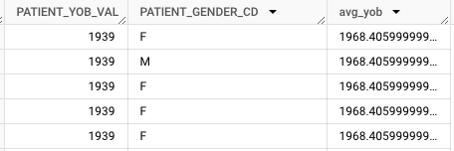
OVER
Aggregate in every row and Non-aggregate columns don't have to part of GROUP BY.
SELECT PATIENT_YOB_VAL,PATIENT_GENDER_CD,
AVG(PATIENT_YOB_VAL) OVER() AS avg_yob,
FROM `purplelab-sales.Training_Dataset.DIM_PATIENT`
ORDER BY PATIENT_YOB_VAL
LIMIT 1000

Slide 6
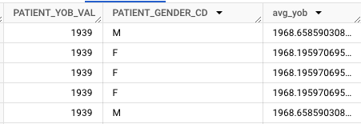
OVER (PARTITION)
PARTITION BY col1, [colN]:
SELECT PATIENT_YOB_VAL,PATIENT_GENDER_CD,
AVG(PATIENT_YOB_VAL) OVER(PARTITION BY PATIENT_GENDER_CD) AS avg_yob,
FROM `purplelab-sales.Training_Dataset.DIM_PATIENT`
ORDER BY PATIENT_YOB_VAL
LIMIT 1000

Slide 7
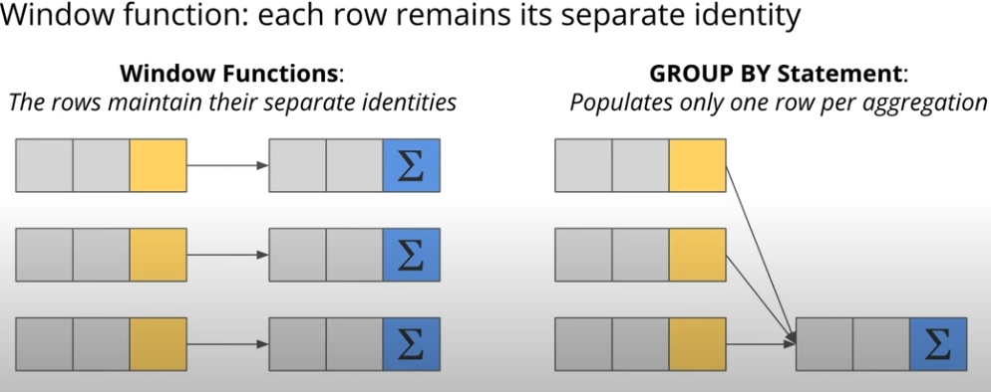
OVER vs. GROUP BY

Slide 8

OVER vs. GROUP BY
SELECT PATIENT_GENDER_CD,
AVG(PATIENT_YOB_VAL) avg_yob
FROM `purplelab-sales.Training_Dataset.DIM_PATIENT`
GROUP BY PATIENT_GENDER_CD
LIMIT 1000

Slide 9
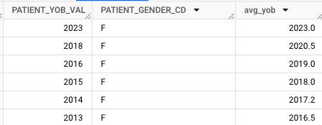
ORDER BY
SELECT PATIENT_YOB_VAL,PATIENT_GENDER_CD,
AVG(PATIENT_YOB_VAL) OVER(PARTITION BY PATIENT_GENDER_CD ORDER BY PATIENT_YOB_VAL DESC) AS avg_yob,
FROM `purplelab-sales.Training_Dataset.DIM_PATIENT`
LIMIT 1000

Slide 10
ROW_NUMBER
Assign a unique number to each row in the query result:
SELECT PATIENT_ID, PATIENT_EDUCATION_ID, HOUSEHOLD_INCOME_PER_PERSON_AMT,
AVG(HOUSEHOLD_INCOME_PER_PERSON_AMT) OVER (PARTITION BY PATIENT_EDUCATION_ID ORDER BY HOUSEHOLD_INCOME_PER_PERSON_AMT DESC) AS avg_income,
ROW_NUMBER() OVER (PARTITION BY PATIENT_EDUCATION_ID ORDER BY HOUSEHOLD_INCOME_PER_PERSON_AMT DESC) AS row_num
FROM `purplelab-sales.Training_Dataset.DIM_PATIENT` LIMIT 1000
Exercise: Try some different columns with this query.

Slide 11
SUB QUERY TOP 2 PAID
Assign a unique number to each row in the query result:
SELECT * FROM
  (SELECT PATIENT_ID, PATIENT_EDUCATION_ID, HOUSEHOLD_INCOME_PER_PERSON_AMT,
  AVG(HOUSEHOLD_INCOME_PER_PERSON_AMT) OVER (PARTITION BY PATIENT_EDUCATION_ID ORDER BY HOUSEHOLD_INCOME_PER_PERSON_AMT DESC) AS avg_income,
  ROW_NUMBER() OVER (PARTITION BY PATIENT_EDUCATION_ID ORDER BY HOUSEHOLD_INCOME_PER_PERSON_AMT DESC) AS row_num
  FROM `purplelab-sales.Training_Dataset.DIM_PATIENT` LIMIT 1000) t
WHERE row_num <3;
Exercise: Try some different columns with this query.

Slide 12
RANK
Assign a rank to each row in the query result:
SELECT * FROM
(SELECT PATIENT_ID, PATIENT_EDUCATION_ID, HOUSEHOLD_INCOME_PER_PERSON_AMT,
AVG(HOUSEHOLD_INCOME_PER_PERSON_AMT) OVER (PARTITION BY PATIENT_EDUCATION_ID ORDER BY HOUSEHOLD_INCOME_PER_PERSON_AMT DESC) AS avg_income,
ROW_NUMBER() OVER (PARTITION BY PATIENT_EDUCATION_ID ORDER BY HOUSEHOLD_INCOME_PER_PERSON_AMT DESC) AS row_num,
RANK() OVER (PARTITION BY PATIENT_EDUCATION_ID ORDER BY HOUSEHOLD_INCOME_PER_PERSON_AMT DESC) AS rank_income
FROM `purplelab-sales.Training_Dataset.DIM_PATIENT` LIMIT 1000) t
WHERE rank_income <4;
Exercise: Try some different columns with this query.

Slide 13
DENSE_RANK
Assign a rank to each row in the query result:
SELECT * FROM
(SELECT PATIENT_ID, PATIENT_EDUCATION_ID, HOUSEHOLD_INCOME_PER_PERSON_AMT,
AVG(HOUSEHOLD_INCOME_PER_PERSON_AMT) OVER (PARTITION BY PATIENT_EDUCATION_ID ORDER BY HOUSEHOLD_INCOME_PER_PERSON_AMT DESC) AS avg_income,
ROW_NUMBER() OVER (PARTITION BY PATIENT_EDUCATION_ID ORDER BY HOUSEHOLD_INCOME_PER_PERSON_AMT DESC) AS row_num,
RANK() OVER (PARTITION BY PATIENT_EDUCATION_ID ORDER BY HOUSEHOLD_INCOME_PER_PERSON_AMT DESC) AS rank_income,
DENSE_RANK() OVER (PARTITION BY PATIENT_EDUCATION_ID ORDER BY HOUSEHOLD_INCOME_PER_PERSON_AMT DESC) AS dense_rank_income
FROM `purplelab-sales.Training_Dataset.DIM_PATIENT` LIMIT 1000) t
WHERE rank_income <4;
Exercise: Try some different columns with this query.

Slide 14
LAG (column, [num rows previous, default])
LAG: Value in the previous row.
SELECT PATIENT_ID, PATIENT_EDUCATION_ID, HOUSEHOLD_INCOME_PER_PERSON_AMT,
LAG (HOUSEHOLD_INCOME_PER_PERSON_AMT)OVER (PARTITION BY PATIENT_EDUCATION_ID ORDER BY HOUSEHOLD_INCOME_PER_PERSON_AMT DESC) AS prev_income,
AVG(HOUSEHOLD_INCOME_PER_PERSON_AMT) OVER (PARTITION BY PATIENT_EDUCATION_ID ORDER BY HOUSEHOLD_INCOME_PER_PERSON_AMT DESC) AS avg_income,
ROW_NUMBER() OVER (PARTITION BY PATIENT_EDUCATION_ID ORDER BY HOUSEHOLD_INCOME_PER_PERSON_AMT DESC) AS row_num,
RANK() OVER (PARTITION BY PATIENT_EDUCATION_ID ORDER BY HOUSEHOLD_INCOME_PER_PERSON_AMT DESC) AS rank_income,
DENSE_RANK() OVER (PARTITION BY PATIENT_EDUCATION_ID ORDER BY HOUSEHOLD_INCOME_PER_PERSON_AMT DESC) AS dense_rank_income
FROM `purplelab-sales.Training_Dataset.DIM_PATIENT` LIMIT 1000

Slide 15
LAG (column, [num rows previous, default])
LAG: Value in the previous row.
SELECT PATIENT_ID, PATIENT_EDUCATION_ID, HOUSEHOLD_INCOME_PER_PERSON_AMT,
LAG (HOUSEHOLD_INCOME_PER_PERSON_AMT)OVER (PARTITION BY PATIENT_EDUCATION_ID ORDER BY HOUSEHOLD_INCOME_PER_PERSON_AMT DESC) AS prev_income,
AVG(HOUSEHOLD_INCOME_PER_PERSON_AMT) OVER (PARTITION BY PATIENT_EDUCATION_ID ORDER BY HOUSEHOLD_INCOME_PER_PERSON_AMT DESC) AS avg_income,
ROW_NUMBER() OVER (PARTITION BY PATIENT_EDUCATION_ID ORDER BY HOUSEHOLD_INCOME_PER_PERSON_AMT DESC) AS row_num,
RANK() OVER (PARTITION BY PATIENT_EDUCATION_ID ORDER BY HOUSEHOLD_INCOME_PER_PERSON_AMT DESC) AS rank_income,
DENSE_RANK() OVER (PARTITION BY PATIENT_EDUCATION_ID ORDER BY HOUSEHOLD_INCOME_PER_PERSON_AMT DESC) AS dense_rank_income
FROM `purplelab-sales.Training_Dataset.DIM_PATIENT` LIMIT 1000

Slide 16
LAG (column, [num rows previous, default])
LAG: Value in the previous row.
SELECT PATIENT_ID, PATIENT_EDUCATION_ID, HOUSEHOLD_INCOME_PER_PERSON_AMT,
LAG (HOUSEHOLD_INCOME_PER_PERSON_AMT)
OVER (PARTITION BY PATIENT_EDUCATION_ID ORDER BY HOUSEHOLD_INCOME_PER_PERSON_AMT DESC) AS prev_income
FROM `purplelab-sales.Training_Dataset.DIM_PATIENT` LIMIT 1000

Slide 17
LAG (column,1, 0)
LAG: Value in the previous row.
SELECT PATIENT_ID, PATIENT_EDUCATION_ID, HOUSEHOLD_INCOME_PER_PERSON_AMT,
LAG (HOUSEHOLD_INCOME_PER_PERSON_AMT, 1, 0)
OVER (PARTITION BY PATIENT_EDUCATION_ID ORDER BY HOUSEHOLD_INCOME_PER_PERSON_AMT DESC) AS prev_income
FROM `purplelab-sales.Training_Dataset.DIM_PATIENT` LIMIT 1000

Slide 18
LAG (column,1, 0) Sub Query
LAG: Value in the previous row.
SELECT PATIENT_ID, PATIENT_EDUCATION_ID, HOUSEHOLD_INCOME_PER_PERSON_AMT,
LAG (HOUSEHOLD_INCOME_PER_PERSON_AMT, 1, 0)
OVER (PARTITION BY PATIENT_EDUCATION_ID ORDER BY HOUSEHOLD_INCOME_PER_PERSON_AMT DESC) AS prev_income
FROM `purplelab-sales.Training_Dataset.DIM_PATIENT` LIMIT 1000

Slide 19
LAG (column,1, 0)
LAG: Value in the previous row.
SELECT * FROM
(SELECT PATIENT_ID, PATIENT_EDUCATION_ID, HOUSEHOLD_INCOME_PER_PERSON_AMT,
LAG (HOUSEHOLD_INCOME_PER_PERSON_AMT,1,0)OVER (PARTITION BY PATIENT_EDUCATION_ID ORDER BY HOUSEHOLD_INCOME_PER_PERSON_AMT DESC) AS prev_income
FROM `purplelab-sales.Training_Dataset.DIM_PATIENT` LIMIT 1000) t
WHERE t.HOUSEHOLD_INCOME_PER_PERSON_AMT=prev_income

Slide 20
LEAD (column, [num rows next, default])
LEAD: Value in the next row.
SELECT PATIENT_ID, PATIENT_EDUCATION_ID, HOUSEHOLD_INCOME_PER_PERSON_AMT,
LEAD (HOUSEHOLD_INCOME_PER_PERSON_AMT,1,0)OVER (PARTITION BY PATIENT_EDUCATION_ID ORDER BY HOUSEHOLD_INCOME_PER_PERSON_AMT DESC) AS next_income
FROM `purplelab-sales.Training_Dataset.DIM_PATIENT` LIMIT 1000

Slide 21
ROWS/RANGE
ROWS: specify a fixed number of rows that precede or follow the current row.
RANGE: specifies the range of values with respect to the value of the current row.

Slide 22
ROWS Example:
SELECT ndc_desc,total_paid_amt,
AVG(total_paid_amt) OVER(ORDER BY total_paid_amt ROWS BETWEEN 3 PRECEDING AND CURRENT ROW) AS avg_total_paid
FROM `purplelab-sales.Training_Dataset.Pharmacy_Clear_Final` LIMIT 1000
SELECT ndc_desc,total_paid_amt,
AVG(total_paid_amt) OVER(ORDER BY total_paid_amt ROWS BETWEEN CURRENT ROW AND 3 FOLLOWING) AS avg_total_paid
FROM `purplelab-sales.Training_Dataset.Pharmacy_Clear_Final` LIMIT 1000

Slide 23
RANGE:
SELECT ndc_desc,total_paid_amt,
AVG(total_paid_amt) OVER(ORDER BY total_paid_amt RANGE BETWEEN 3 PRECEDING AND CURRENT ROW) AS avg_total_paid
FROM `purplelab-sales.Training_Dataset.Pharmacy_Clear_Final` LIMIT 1000
SELECT ndc_desc,total_paid_amt,
AVG(total_paid_amt) OVER(ORDER BY total_paid_amt RANGE BETWEEN CURRENT ROW AND 3 FOLLOWING) AS avg_total_paid
FROM `purplelab-sales.Training_Dataset.Pharmacy_Clear_Final` LIMIT 1000

Slide 24
Working session
Any case studies?

Slide 25
NEXT
Questions?
Working sessions.
Use Cases to review.

